Slide 1
PhYSICS INFORMED Machine learning
By:-
Ankit varshney(210121069)
Kovid juneja (220101059)

Slide 2
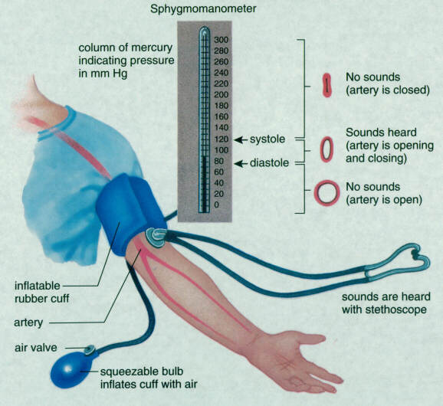
Systolic blood pressure detection with beat time
This Photo by Unknown author is licensed under CC BY-NC-ND.

Slide 3
Works which we have done
1)CNN model to reduce features
2)LSTM to have the time methodolgy

Slide 4
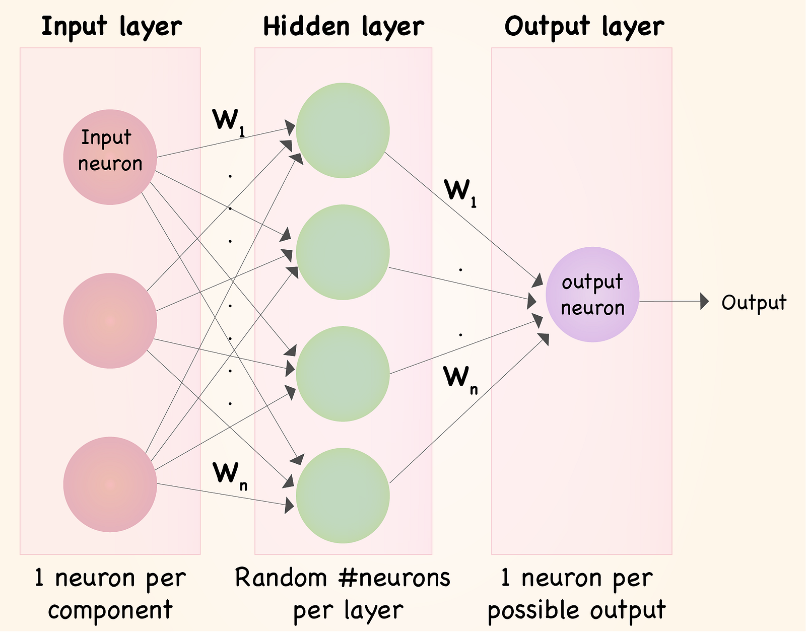
WHy cnn
Convolutional Neural Networks (CNN) - These neural networks are renowned for extracting the crucial parameters that heavily influence our dataset. Due to their success in applications like image classification, object detection, and semantic segmentation, we aim to leverage the power of CNNs to uncover intricate patterns and relationships within our data, ultimately enhancing our understanding and decision-making processes.

Slide 5
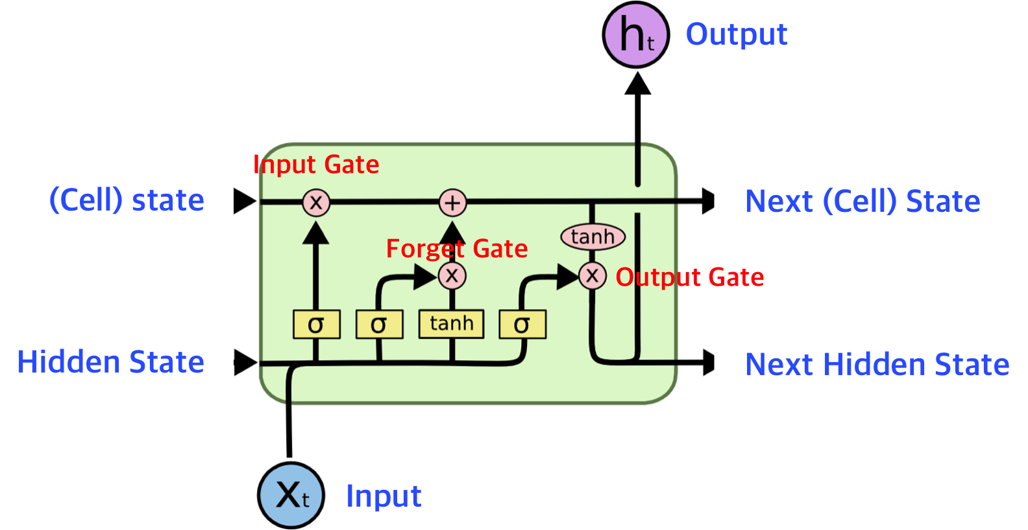
WHY Long short term memory unit(LSTM)
In the LSTM model, we retain prior values from the training set to consider dependencies between current and earlier data. This method could be used to forecast blood pressure, a health metric where current status often depends on past conditions, ensuring a thorough analysis of data that may have occurred earlier. In this way, the LSTM model effectively captures the sequential patterns inherent in the data, allowing for more accurate predictions and insights into complex time series data such as blood pressure fluctuations. By leveraging the memory capabilities of LSTM networks, we could better understand the underlying dynamics of physiological processes and make informed decisions based on historical trends and patterns.
This Photo by Unknown author is licensed under CC BY-NC-ND.

Slide 6
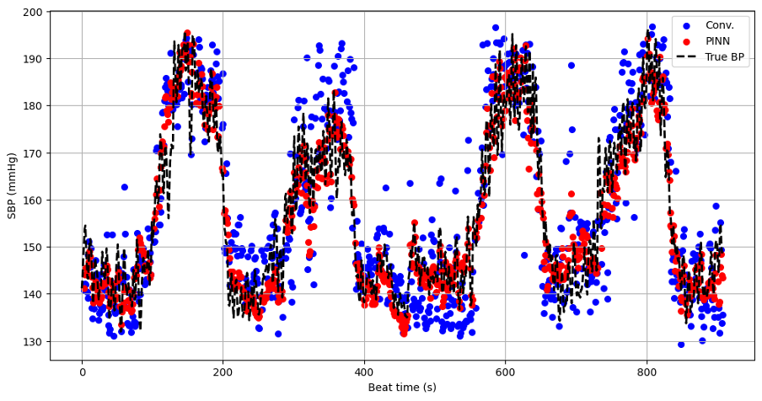
Our MODEL which was trained
Enhancing your presentation

Slide 7
Basic definations for understanding results
RMSE (Root Mean Squared Error) is a statistical measure of the average magnitude of the errors between predicted and observed values in a regression analysis. It squares the differences between predicted and actual values, computes their mean, and then takes the square root to provide a measure in the same units as the original data. RMSE is commonly used to assess the accuracy of predictive models, with lower values indicating better performance.
Correlation:-It quantifies the strength and direction of the relationship between two variables. It ranges from -1 to 1, where 1 signifies a perfect positive correlation, -1 denotes a perfect negative correlation, and 0 indicates no correlation. Correlation analysis aids in feature selection, identifying redundant features, and understanding variable interactions within a dataset. However, correlation does not imply causation; a correlation between variables does not necessarily imply that changes in one variable cause changes in the other.

Slide 8
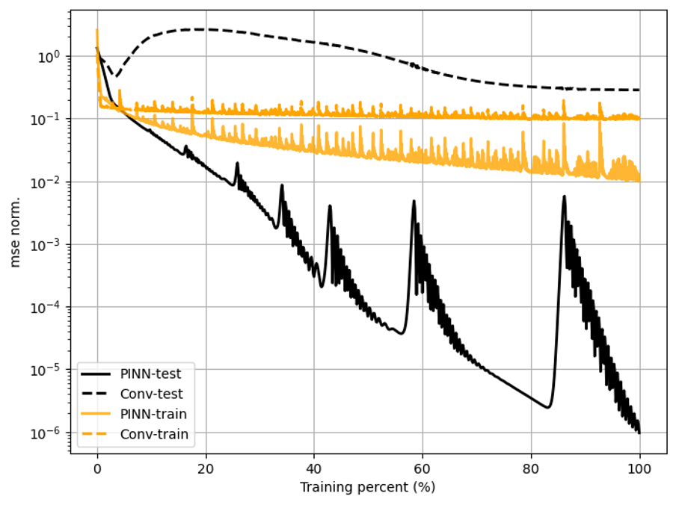
REsults comparison of cnn-LSTM with pinn

Slide 9
Parameters obtained
CNN-LSTM model:-
Corr-0.89
RMSE-8.9

Slide 10
Parameters of pinn model
Coff-0.95
RMSE-5.3

Slide 11

CELEBration
So our model worked close too the standard model
Hurray!

Slide 12
Thank you

